Slide 1

Hamming Code design system
Names:
1. Ahmed Mohammed Mahmoud Ibrahim
2. Ziad Mohammed Abdulhamed
3. Ahmed Mohamed Ramadan
4. Mohammed Ayman Fathy
5. Mahmoud Mohsen Moawad

Slide 2
Introduction:
At this document we present hamming code design system which is one of the methods used to make error detection and correction to the data. While the data go through a line from transmitter to the reciever, it may suffer from some noise which make an error in the data bits, so we use 7,4 hamming code to manage our system to detect that error and then correct it. 7, 4 Hamming code depends on concatenating 3 bits in a specific order to every 4 data bits, then we use these bits to detect the error and correct it in order to deliver the data to the reciever correctly.

Slide 3
Here we designed 7,4 hamming code system using “Verilog” for error detection and correction and we used for this design 4 blocks to take serial input and then make data go serial all the way then reach the reciever. These are the 4 blocks as shown below:
Serial To parallel
4,7 hamming Encoder
7,4 hamming decoder
Parallel to serial

Slide 4
Serial to parallel
As required in the design that we want a serial input to be given to the system and also that input will enter the encoder which takes 4 bit data and concatenate them with the three parity bits to convert it from 4 to 7 bit, that encoder in our design takes parallel input so we needed a serial to parallel to convert serial input to parallel which is suitable for encoder, so this block takes serial bits and collect them in parallel to enter the encoder. This block takes every serial bit and store it in a temporary register so it will make shift on each input serial data as long as the counter < 4, so when the counter reaches 4 (the number of input data I want ) the shift will stop and the 4 shifted data will assigned to the output to enter the encoder as parallel

Slide 5
module serialToParallel(clk,d,out);
input clk;
input d;
output reg[3:0] out;
reg[3:0] counter=0;
reg [3:0]q=0;
always@(posedge clk)
begin
if (counter < 4)begin
q[3]<=d;
q[2]<=q[3];
q[1]<=q[2];
q[0]<=q[1];
Counter = counter +1
end
else
begin
q<=q;
end
end
out = q;
endmodule

Slide 6
2. Encoder
Encoder is the second block which receives the parallel data from serial to parallel and then start to make error detection, encoder takes 4 bit parallel and gives 7 bits parallel. The process of error detection is done by concatenating 3 parity bits p1,p2,p4 by the following order:
So that,
P1 = D3^D5^D7
P2 = D3^D6^D7
P4 = D5^D6^D7
D7 | D6 | D5 | p4 | D3 | p2 | p1

Slide 7
3. Parallel to serial
The encoder will give 7 bit parallel output and as we want the data to go serial in it’s way to the decoder, we should have parallel to serial block after the encoder so it will convert the parallel encoder output to serial. This block contains a counter which counts the shifted data so when the counter reach to 7 we will store the parallel input in a temporary register and increase counter 1, while the counter is more than 7 then it will start to shift the data and put data [0] to the output serial until the seven bits completely shifted as shown in the code in the following page.

Slide 8
module parallel_to_serial_7
(
input clk,
input[6:0] data_in,
output serial_out
);
reg[6:0] counter;
reg[6:0] data;
always @(posedge clk)
begin
counter<=counter+1;
if (counter ==7)begin
data<=data_in;
end
else if (counter > 7 )begin
data<={1'b0,data[6:1]};
end
end
assign serial_out=data[0];
endmodule

Slide 9
4.Serial to parallel
The data is going serial through it’s way until it will reach the decoder, the decoder need 7 parallel data input but the data is coming serial so we need a serial to parallel block will take 7 data bits and convert them to parallel data so it will be suitable to enter the decoder which needs a parallel input. This block takes 1 serial input and has a counter 5 bits. The counter will count but doesn’t effect the data or doing any shift until it reach > 7, so when counter is more than 7 the shift process will begin until it shifts all 7 bits and collect them, then the 7 parallel bits will be stored to the output to enter the decoder.

Slide 10
5. Decoder
Decoder is considered the most important block in the system as it is responsible for making error correction and returning the data to it’s original(main four bits). The process in the decoder will be done as follow,
Firstly we need to check if the data was changed or not so we will create variable called error index so it will take one of the three parity bits(p1,p2,p4) and the belonged data bits to each one and make xor to then.
P1 with D3,D5,D7
P2 with D3,D6,D7
P4 with D5,D6,D7

Slide 11
Xor( error index[0],P1, D3,D5,D7)
Xor( error index[1],P2, D3,D6,D7)
Xor( error index[2],P4, D5,D6,D7)
Then we see if error index = 0, it means that there is no error. If any bit changed from zero it means that there is an error and it will be at the index which equal to error index, so we will go to that index and convert the data bit in it.

Slide 12
module hamm_decoder(input [7:1]in,output reg [3:0]out, output reg[2:0] error_index);
reg [7:1]IN;
always @(*)
begin
error_index[0] = in[1]^in[3]^in[5]^in[7];
error_index[1] = in[2]^in[3]^in[6]^in[7];
error_index[2] = in[4]^in[5]^in[6]^in[7];
if(error_index == 3'b000)begin
out[0] = in[3];
out[1] = in[5];
out[2] = in[6];
out[3] = in[7];
end
else
begin
IN = in;
IN[error_index] = !IN[error_index];
out[0] = IN[3];
out[1] = IN[5];
out[2] = IN[6];
out[3] = IN[7];
end
end
endmodule

Slide 13
6. Parallel to serial
The last block will convert the parallel output to serial because we need the final output as serial.
module parallel_to_serial
(
input clk,
input[3:0] data_in,
output reg serial_out
);
reg[3:0] counter=0;
reg[3:0] data;
always @(posedge clk)
begin
counter<=counter+1;
if (counter ==7)begin
data<=data_in;
end
else if (counter > 7 )begin
data<={1'b0,data[3:1]};
serial_out<=data[0];
end
end
endmodule

Slide 14
Hammimg code module:
It is the final module which collects all the blocks and delivers each block to the next block, to control the data we used two clocks, clk1 and clk2 which are used to control moving data in the system.
Hint:
Clk2 has double of the frequency of clk1 to manage maving data and entering it from one block to the other.

Slide 15
module encdecoder(input serial_in,input clk1,input clk2,output serial_outt,output med,output [6:0] regdec,output[3:0] decoout,output re2out);
wire [3:0] q_4 ;
wire [6:0] ham_out;
wire ser_7;
wire [6:0] q_7;
wire serial_out;
wire [3:0] dec_out;
serialToParallel STP_en (.clk(clk1),.d(serial_in),.out(q_4));
hamming_encoder en (.data_in(q_4),.ham_out(ham_out));
parallel_to_serial_7 PTS_en (.clk(clk2),.data_in(ham_out),.serial_out(ser_7));
serialToParallel_7 STP_dec (.clk(clk2),.d(ser_7),.out(q_7));
assign regdec=q_7;
hamm_decoder dec (.in(q_7),.out(dec_out),.error_index(error_index));
assign decoout=dec_out;
parallel_to_serial PTS_dec (.clk(clk1),.data_in(dec_out),.serial_out(serial_out));
assign re2out=serial_out;
assign med =ser_7;
assign serial_outt =serial_out;
endmodule

Slide 16
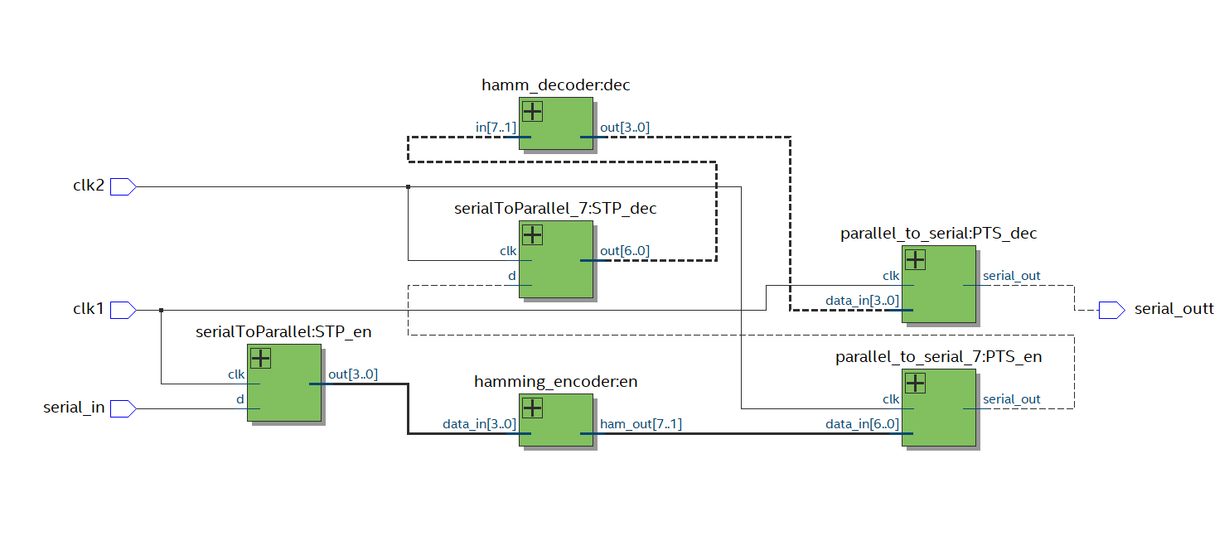
RTL:

Slide 17
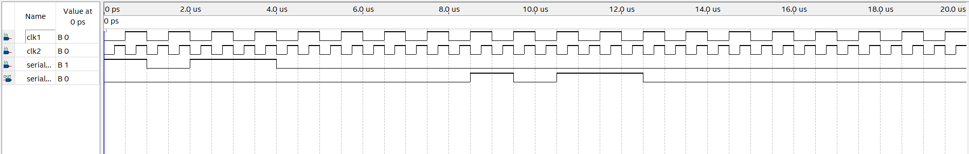
Input:

Slide 18
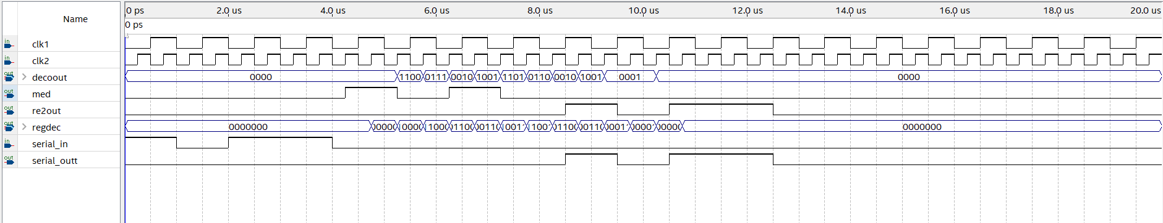
Result of the simulation

Slide 19
Testbench
`timescale 1 ps/ 1 ps
module encdecoder_vlg_vec_tst();
reg clk1;
reg clk2;
reg serial_in;
// wires
wire [3:0] decoout;
wire med;
wire re2out;
wire [6:0] regdec;
wire serial_outt;
encdecoder i1 (
.clk1(clk1),
.clk2(clk2),
.decoout(decoout),
.med(med),
.re2out(re2out),
.regdec(regdec),
.serial_in(serial_in),
.serial_outt(serial_outt)
);

Slide 20
initial
begin
#20000000 $stop;
end
// clk1
always
begin
clk1 = 1'b0;
clk1 = #500000 1'b1;
#500000;
end
// clk2
always
begin
clk2 = 1'b0;
clk2 = #250000 1'b1;
#250000;
end
// serial_in
initial
begin
serial_in = 1'b1;
serial_in = #1000000 1'b0;
serial_in = #1000000 1'b1;
serial_in = #2000000 1'b0;
end
endmodule

